Slide 1
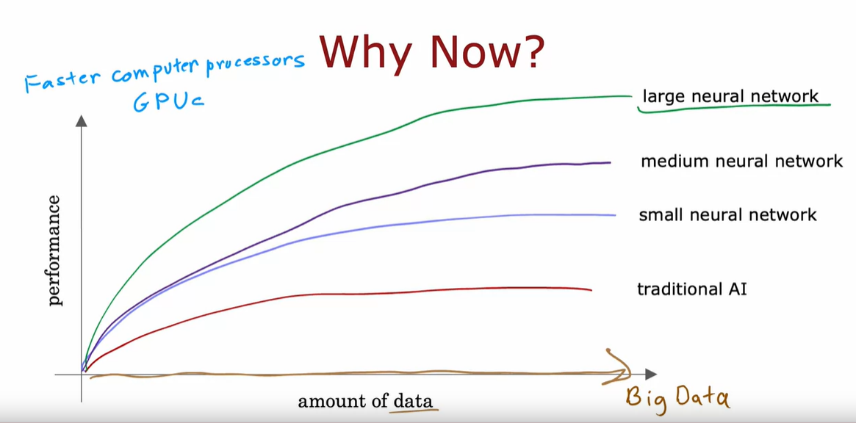
NEURAL NETWORKS
Neural Networks had started with the motivation of trying to build a software that mimics the human brain. At this point, NNs take inspiration from, but do not very accurately mimic, how neurons in a biological brain learn.
NN software building was re-branded to DEEP LEARNING in 2005, with first inroads in Speech Recognition, then Computer Vision, then NLP and now other areas
Why NNs are gaining popularity now?
Tradition AI/ML algorithms such as linear and logistic regression do not scale well with the amount of data
NNs can take advantage of big data – just adding more neurons helped gain performance/accuracy
Faster processing architectures/GPUs are also a major driving force in allowing deep learning algos to scale

Slide 2
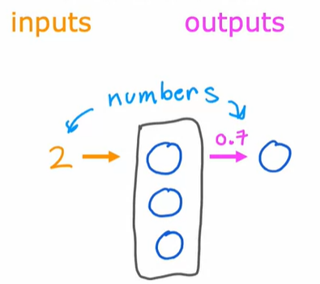
Simplified Neuron
Activation – A term in neuroscience, referring to how much signal a neuron is sending to other downstream neurons.
Layers – A grouping of neurons which takes as input some or similar features and then outputs a few numbers together. A layer can have single or multiple neurons. The output of each layer are its activation values.
Input Layer – First layer of NN that takes a list of inputs (vector of features)
Output Layer – Final layer that outputs a probability/prediction score
Hidden Layer – Layers in middle (between the input and output layer) are called hidden layers
The way a NN works in practice is that each neuron in a certain layer will have access to every value from previous layers/input layer (hence each layer is interconnected)
In a NN, instead of manual feature engineering, the NN learns its own features to make the learning problem easier for itself. This is done in the hidden layers.
In a base/standard neural network, each neuron is a LOGISTIC Unit.
The question of how many layers and how many neurons within each layer is a question of the architecture of the NN. This impacts the performance of the learning algo.
A NN with multiple hidden layers is also know as a “Multilayer Perceptron”

Slide 3
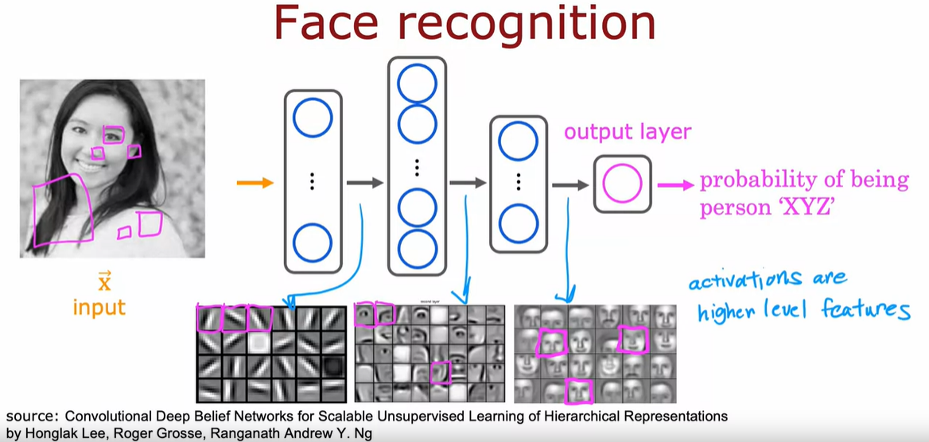
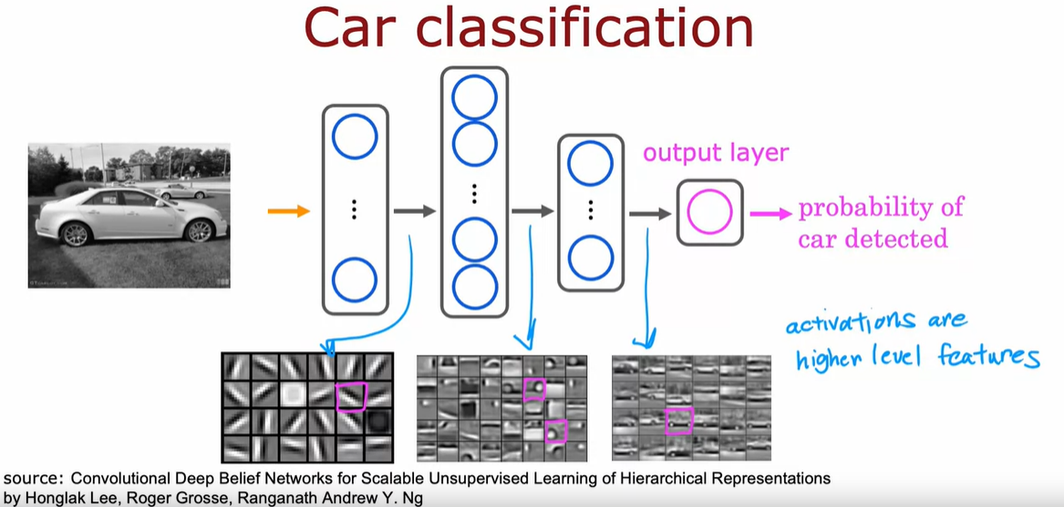
Examples
NOTE: Activations are higher level features
NN Model
Every layer inputs a vector of numbers and applies one-to-many logistic regression units to it and the computes another vector of numbers that gets passed from layer to layer to the final output layers computation which is the prediction of the NN. You can then either threshold at 0.5 to classify Y or come up with the final prediction.

Slide 4
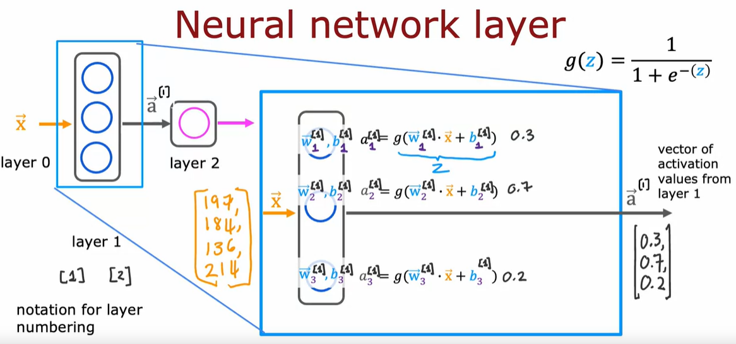
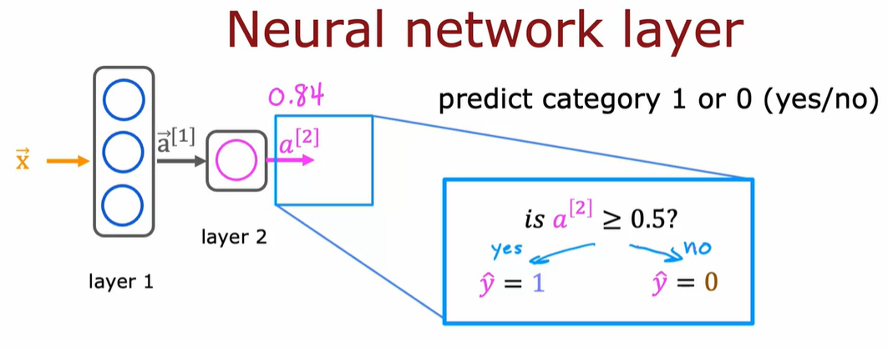
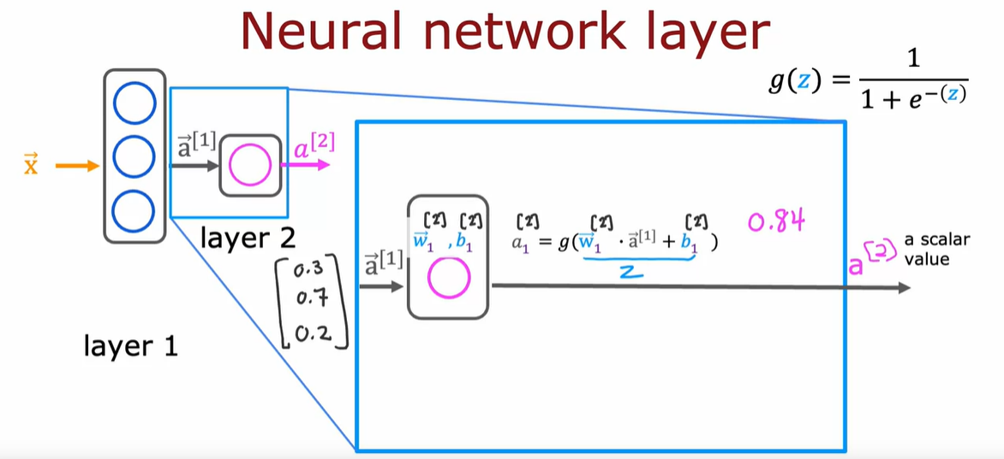
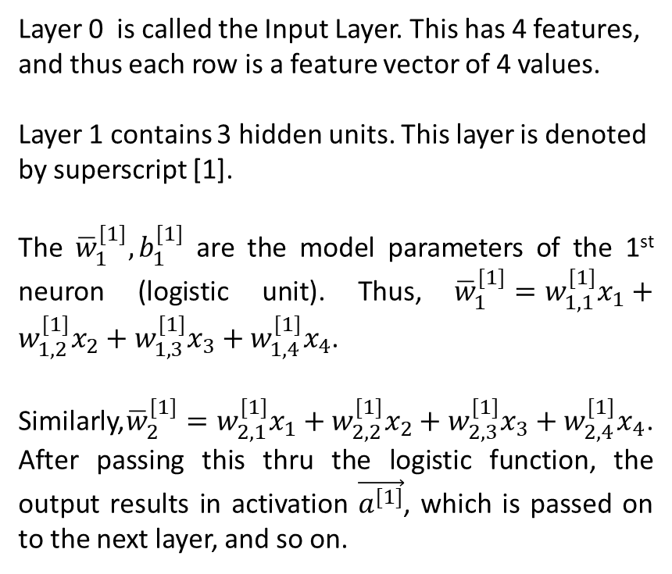
STEP 1
STEP 3
Layer 0 is called the Input Layer. This has 4 features, and thus each row is a feature vector of 4 values.
Layer 1 contains 3 hidden units. This layer is denoted by superscript [1].
The ${\overline{w}}_{1}^{[1]},b_{1}^{[1]}$ are the model parameters of the 1st neuron (logistic unit). Thus, ${\overline{w}}_{1}^{[1]}=w_{1,1}^{[1]}x_{1}+w_{1,2}^{[1]}x_{2}+w_{1,3}^{[1]}x_{3}+w_{1,4}^{[1]}x_{4}$.
Similarly,${\overline{w}}_{2}^{[1]}=w_{2,1}^{[1]}x_{1}+w_{2,2}^{[1]}x_{2}+w_{2,3}^{[1]}x_{3}+w_{2,4}^{[1]}x_{4}$. After passing this thru the logistic function, the output results in activation $\vec{a^{[1]}}$, which is passed on to the next layer, and so on.
STEP 2

Slide 5
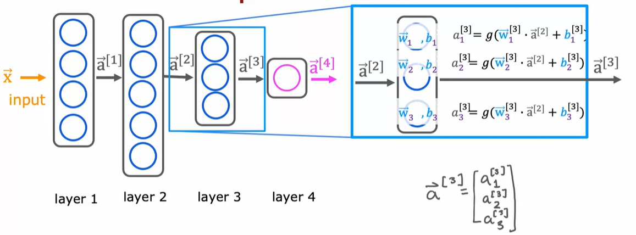
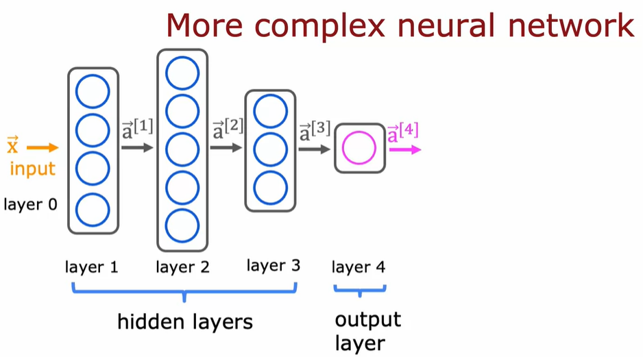
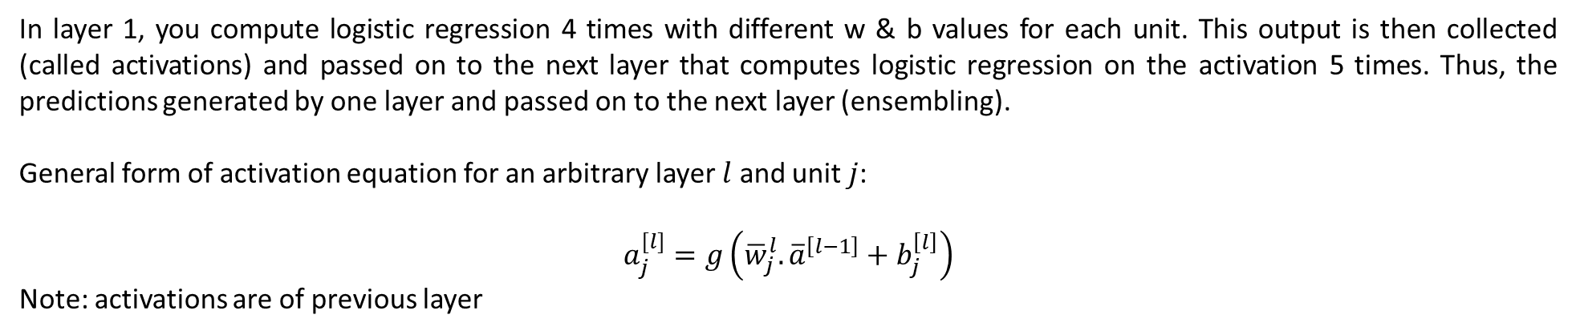
Complex NN
By convention, when we say a NN has 4 layers, we exclude Layer 0 (which is the input feature vector) and count the rest of the layers including the output layer.
In layer 1, you compute logistic regression 4 times with different w & b values for each unit. This output is then collected (called activations) and passed on to the next layer that computes logistic regression on the activation 5 times. Thus, the predictions generated by one layer and passed on to the next layer (ensembling).
General form of activation equation for an arbitrary layer $l$ and unit $j$:
$$a_{j}^{[l]}=g\left({\overline{w}}_{j}^{l}.{\overline{a}}^{\left[l−1\right]}+b_{j}^{\left[l\right]}\right)$$
Note: activations are of previous layer

Slide 6
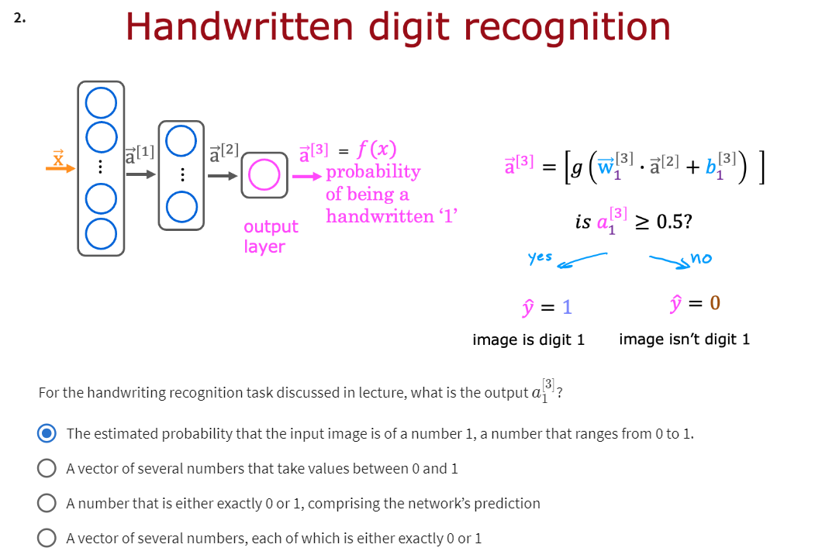
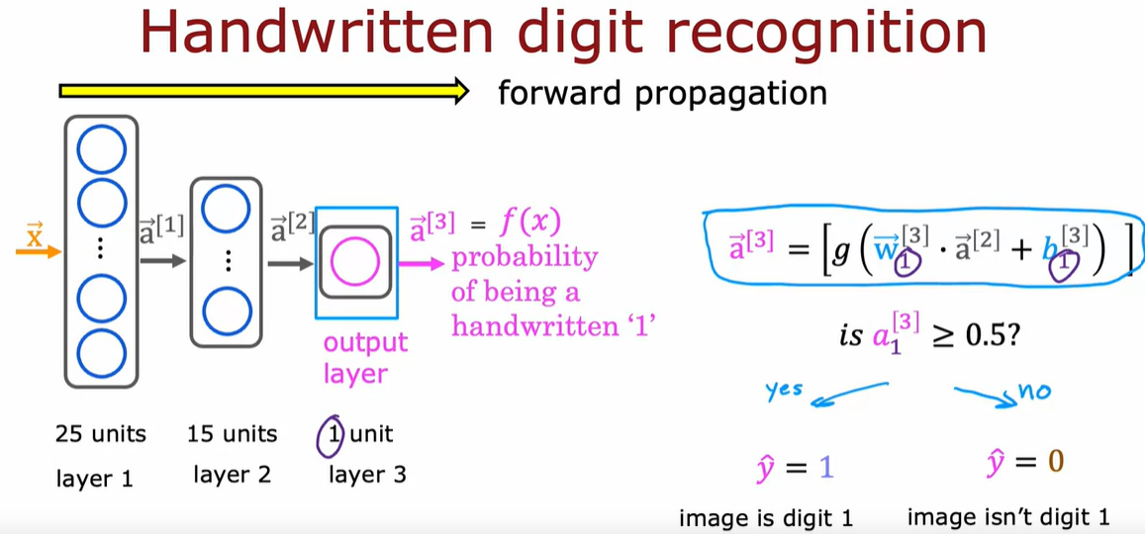
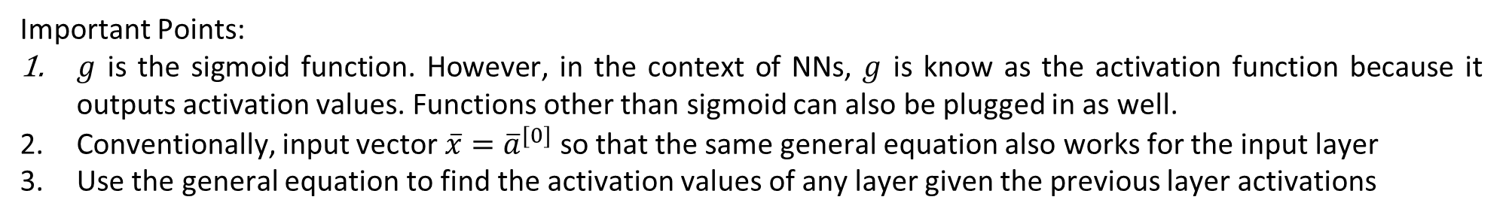
Important Points:
$g$ is the sigmoid function. However, in the context of NNs, $g$ is know as the activation function because it outputs activation values. Functions other than sigmoid can also be plugged in as well.
Conventionally, input vector $\overline{x}={\overline{a}}^{[0]}$ so that the same general equation also works for the input layer
Use the general equation to find the activation values of any layer given the previous layer activations
Forward Propagation
The process of taking an input feature and passing it through all the layers of a NN and making a prediction is called forward propagation. With forward propagation, you can download the parameters of a NN someone else has trained and carry out inference (prediction) on your data using their NN.

Slide 7
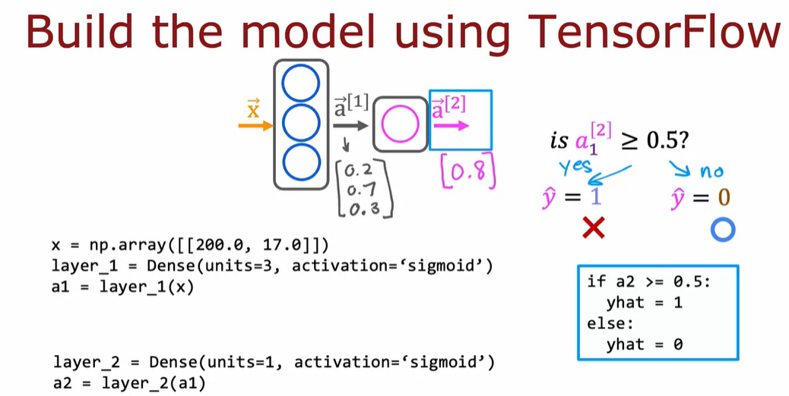
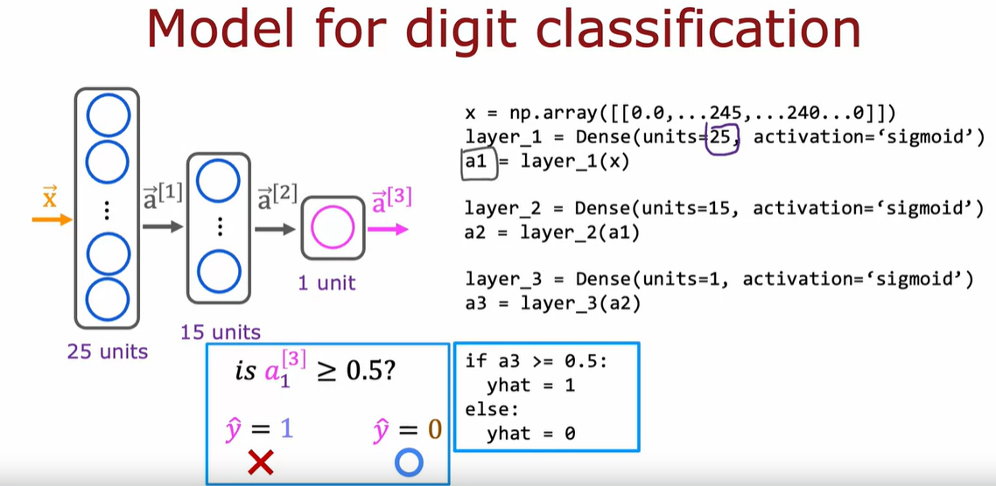
TensorFlow and Keras
- TensorFlow is a machine learning package developed by Google. In 2019, Google integrated Keras into TensorFlow and released TensorFlow 2.0.
- Keras is a framework that creates a simple, layer-centric interface to TensorFlow
- A Tensor is a data type created to store and carry out computations effectively on matrices. Thus, tensors are ways of representing matrices.
- Tensors has a different way of representing matrices when compared to Numpy matrices
Note: - TensorFlow works only on matrices. Therefore, 1D arrays need to be changed to 1 x 2 matrices

Slide 8
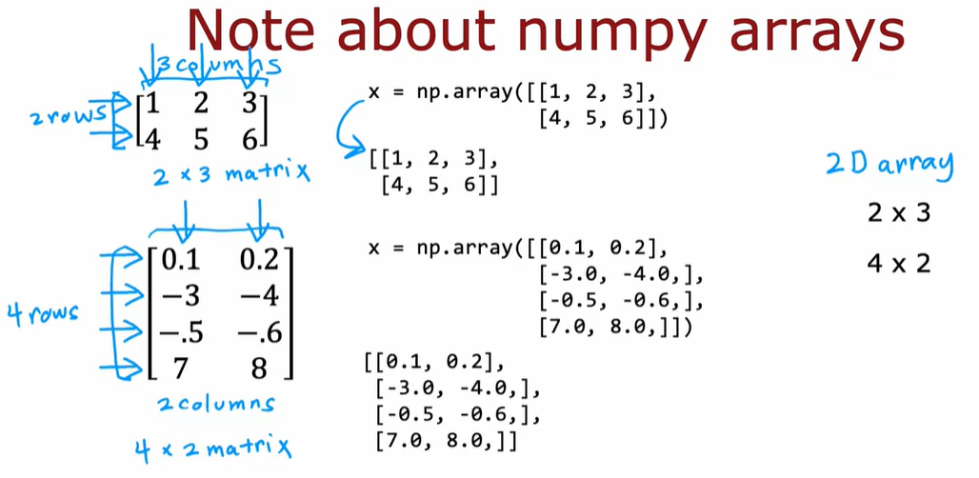
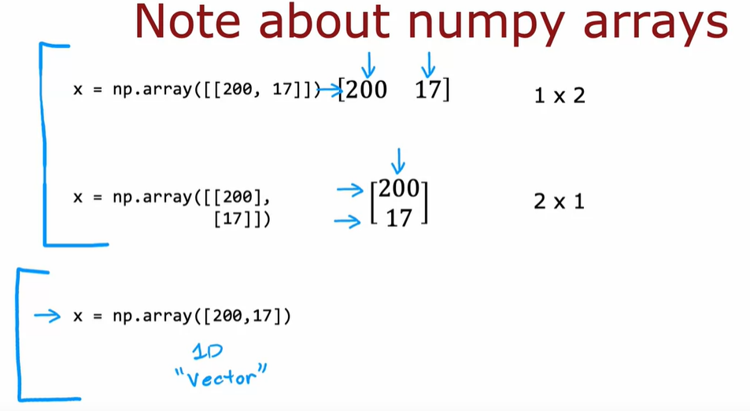
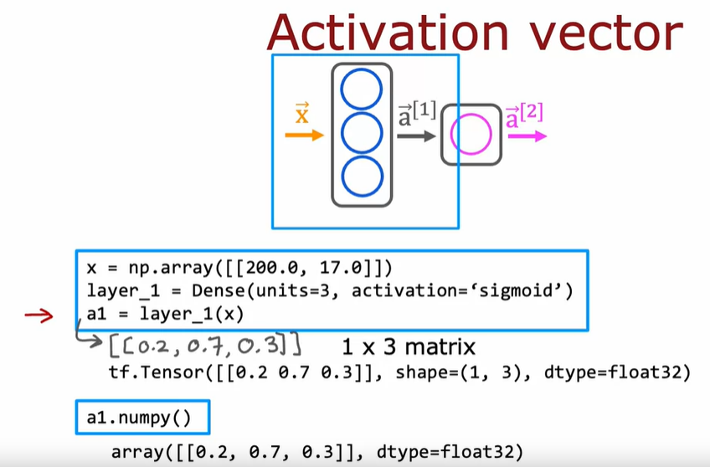
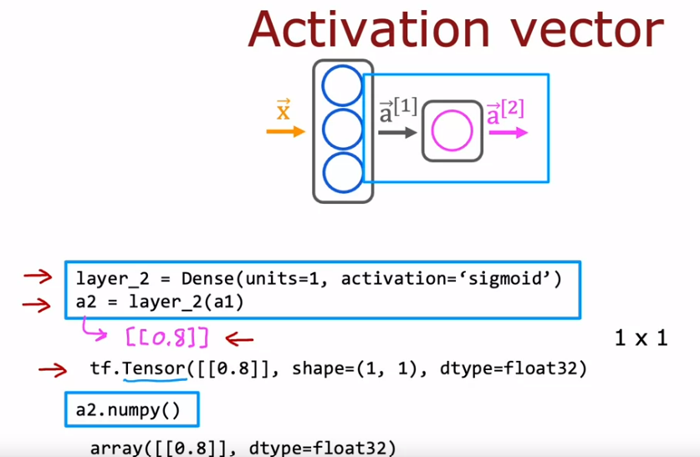

Slide 9
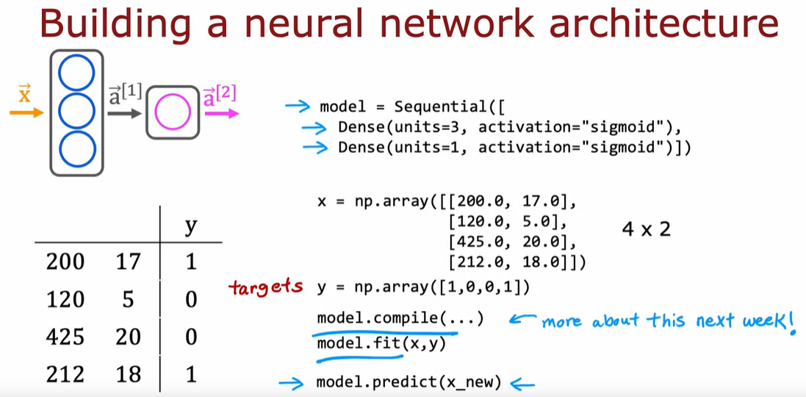
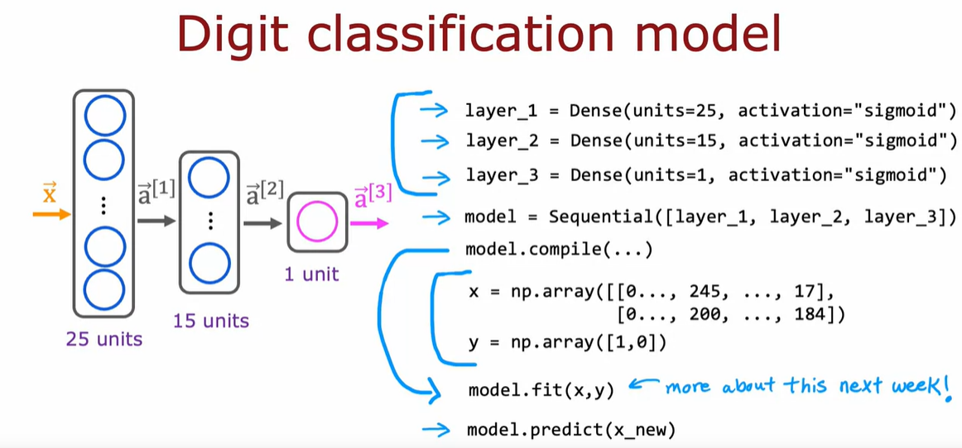
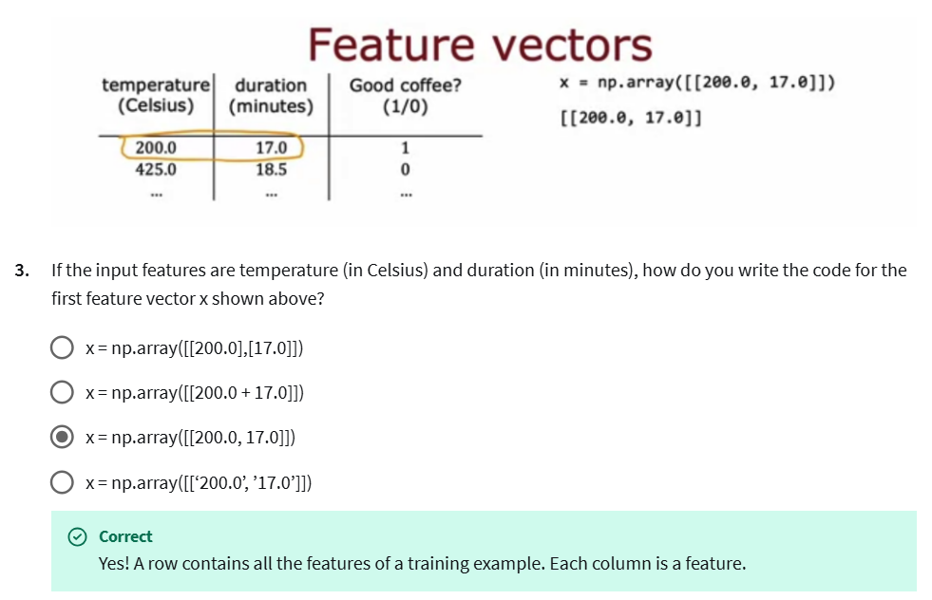
Final Implementation of NN using TF
Note:
- To carry out inference/prediction, use the model.predict() function.
- The compile and the fit function carry out model training

Slide 10
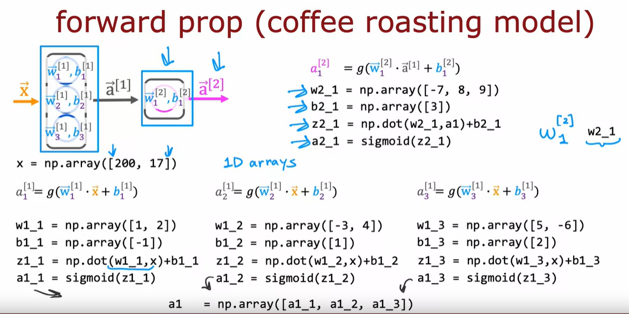
Python Implementation of Forward Prop

Slide 11
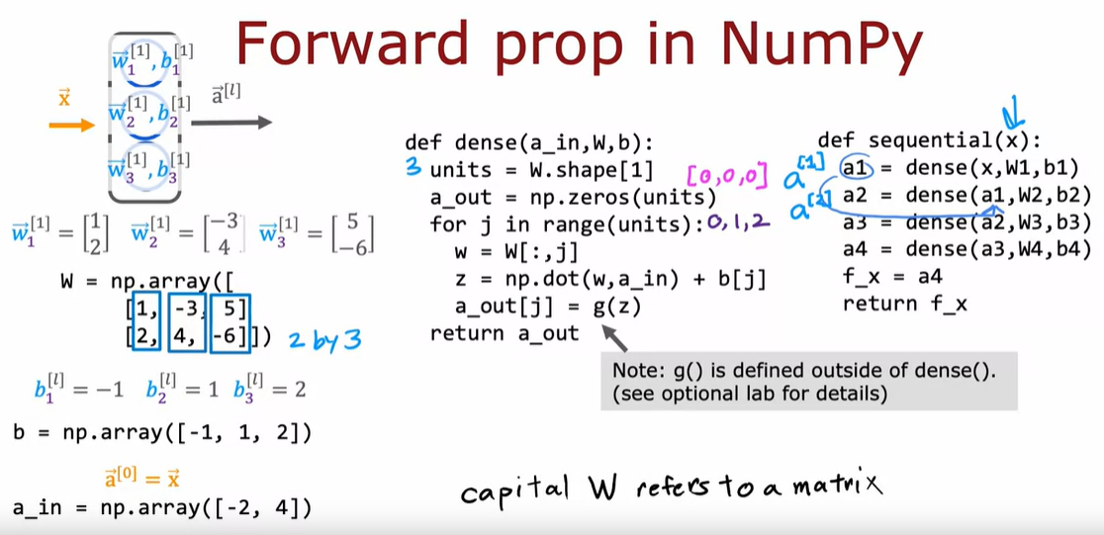
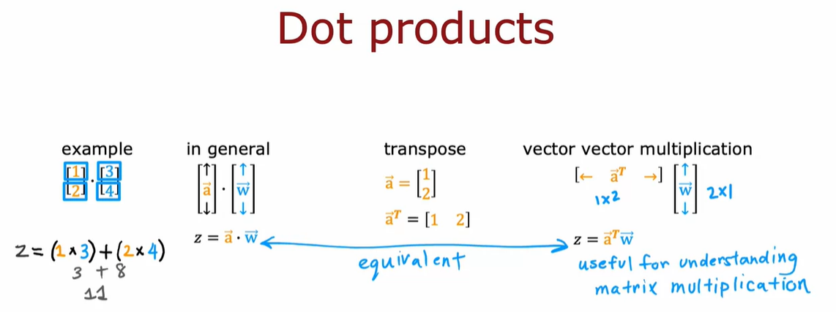
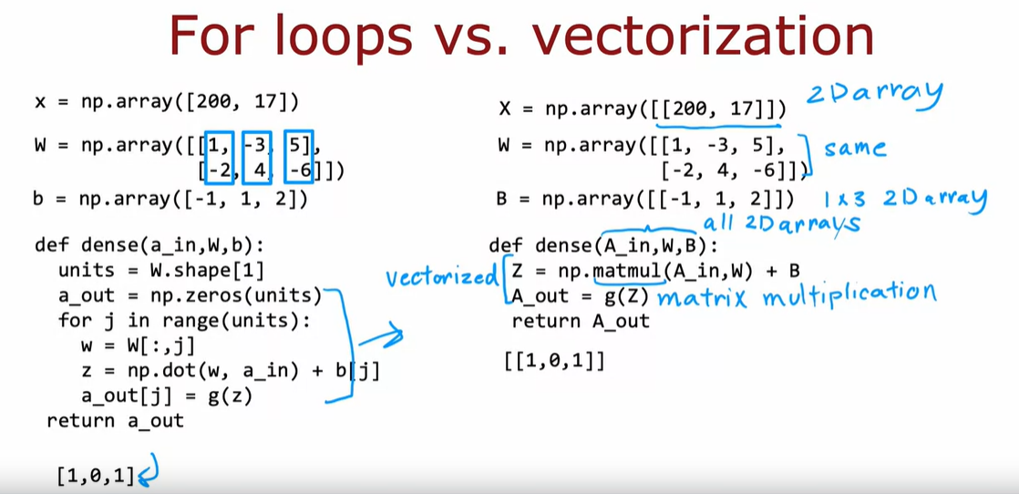
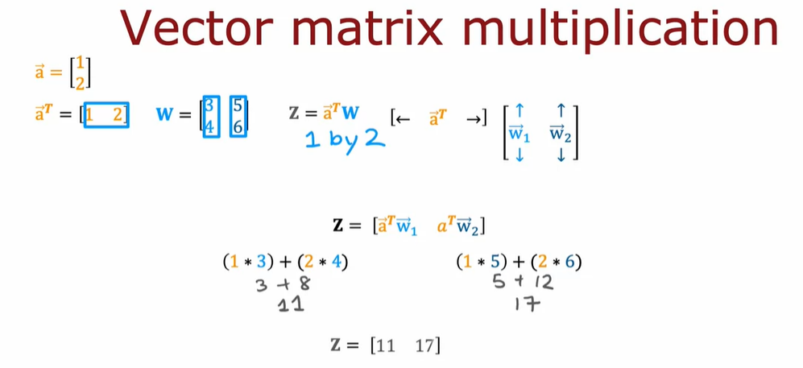
Non-vectorized Implementation:
Understanding vectorized Implementation:
Step1: Dot Product Overview
Vectorized Implementation:
Step2: Vectorized Matrix Multiplication

Slide 12
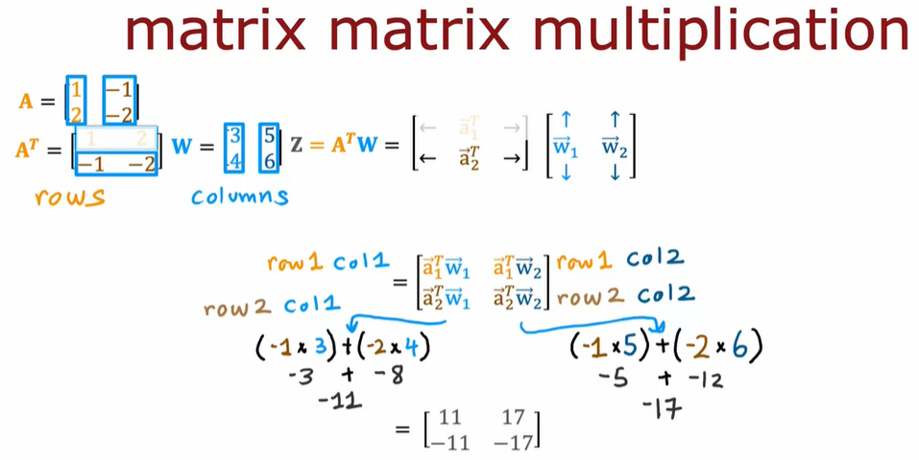
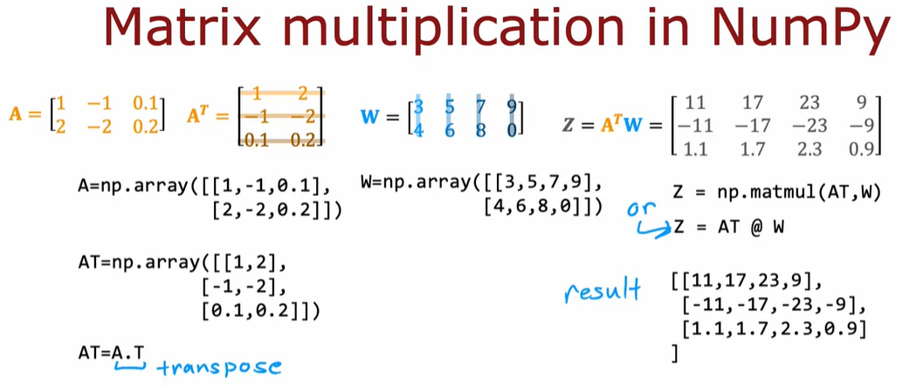
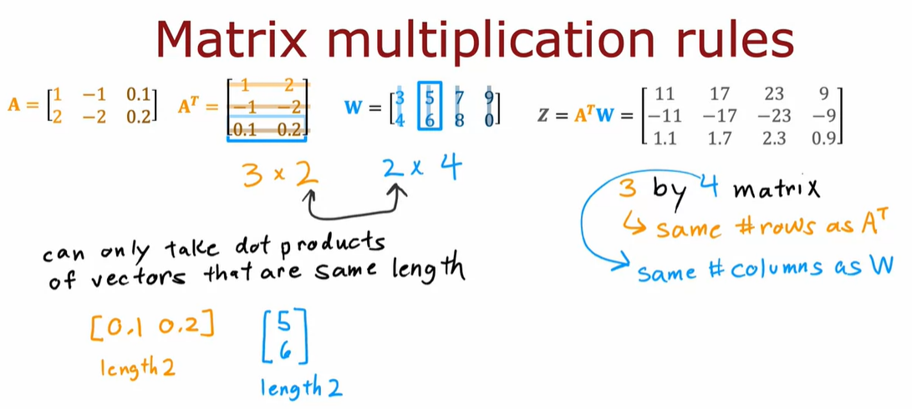
Step3: Matrix-Matrix Multiplication
Note on Step4: In order to abide to matrix multiplication rules, especially for non-square matrices, A transpose is multiplied by W instead of A. In step1, it is shown that the dot product of A*W and A-Transpose*W is equivalent.
Also, during implementation, A-Transpose can be thought of as each row of the data set
Step5: Matrix-Matrix Multiplication in Numpy
Step4: Matrix-Matrix Multiplication Rules

Slide 13
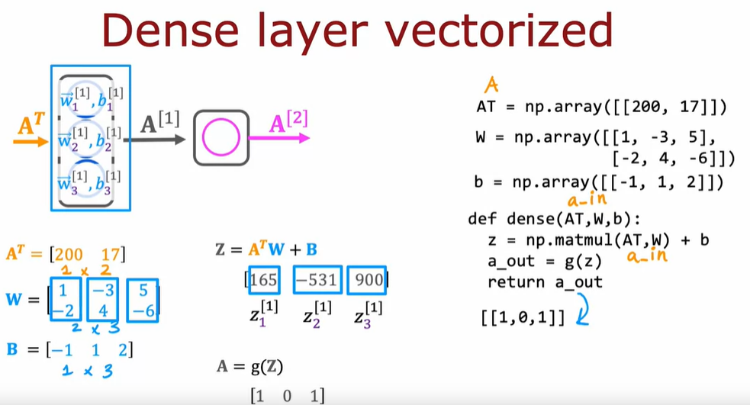
Vectorized Dense Layer Implementation
Explanation:
1] AT = row input of vectors
2] W = matrix of weights for each unit/neuron stacked as columns. Weight [1, -2] is for X1 and X2 respectively.
3] b = matrix of bias
4] z = arranging equation this way gives value if z1, z2, ..
5] a_out = this is [1 0 1] because the values were very close of [1 0 1] in the example

Slide 14
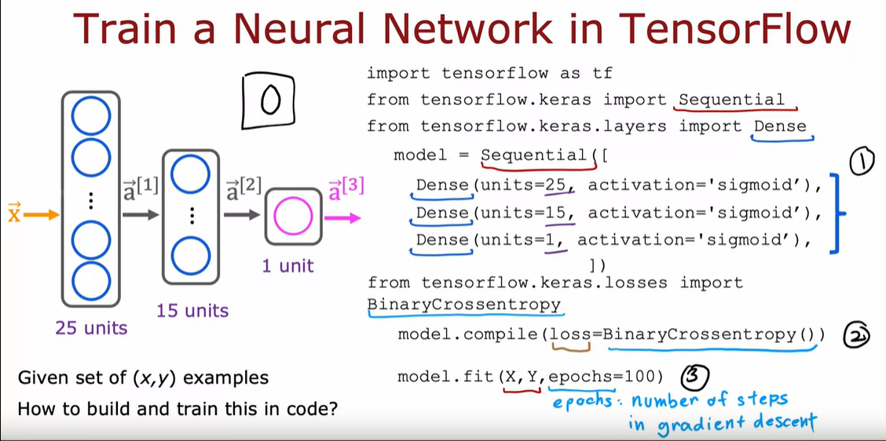
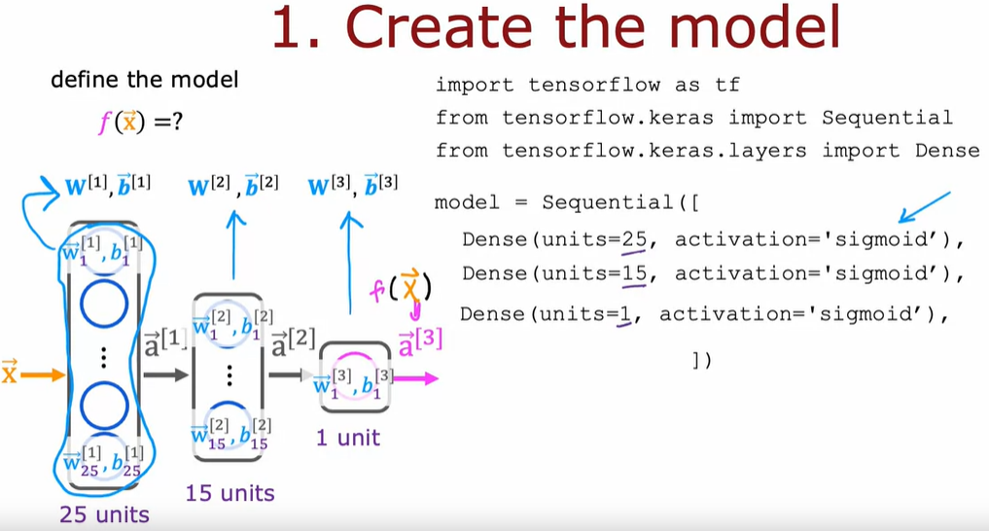
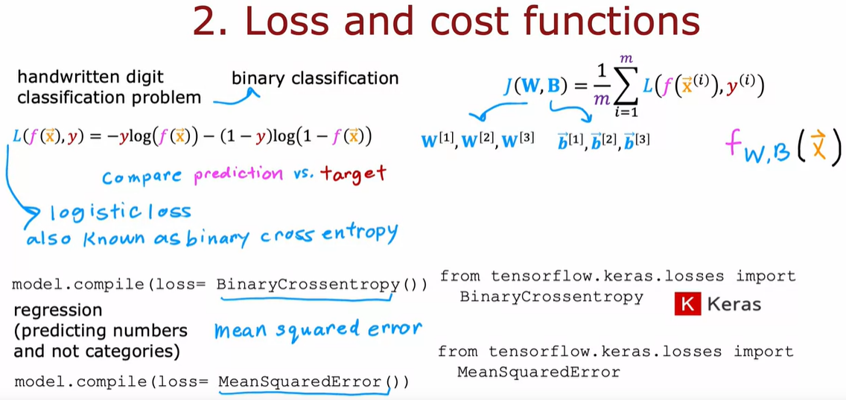
Train a NN in TF
Step1 – Specify the model which tells TF how to compute inference
Define the number of layers and the units within each layer
Step2 – Compile the model using a specific loss function
The baseline loss function is the logistic loss (aka binary cross-entropy loss) for classification problems and the mean squared error loss for Regression problems.
Step3 – Train the model
Note: TF automatically calculates the cost by averaging across individual losses

Slide 15
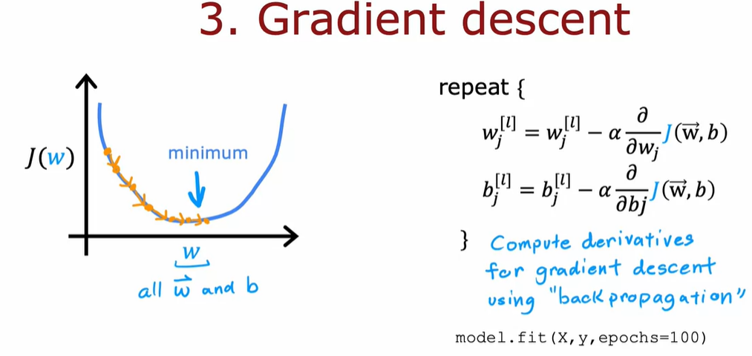
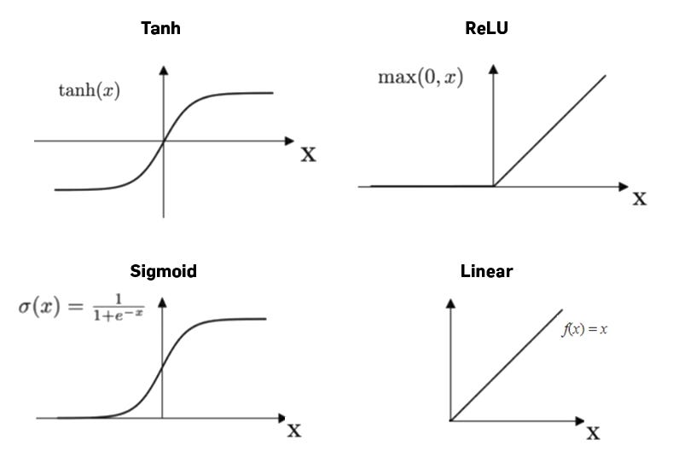
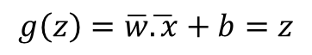
In order to use Gradient Descent, a key step is to compute partial derivatives.
The backpropagation algorithm is standard practice to compute partial derivatives.
Simply using model.fit() performs back-prop in TF
ACTIVATION FUNCTIONS
So far, we’ve been building the NNs by taking logistic regression units and stringing them together
Rather than modeling neurons as binary numbers between 0 and 1 (used for estimating probabilities), alternatively, a neuron could be modelled as any non-negative number (0 up to a very large number). To allow a value > 1 ( and outside the range of 0 and 1), we could use the RELU activation or LINEAR activation functions
g(z) = max(0, z)
If z < 0 ➔ g(z) = 0
If z >= 0 ➔ g(z) = z
$$g\left(z\right)=\overline{w}\overline{.x}+b=z$$

Slide 16
Note: If you use the linear activation function, you are not using any activation function as such because the output of the dot product of the input and the weight plus the sum is passed to another layer as is. Hence, sometimes this activation function is also called “No Activation Function”
How to choose an Activation Fn?
When choosing the activation function for the output layer, there is often one fairly neutral choice depending on the target label
If y = 0 or 1 → Choose the sigmoid activation because this is a binary classification problem
If y = +ve or –ve → Choose the linear activation because the NN can take up any value to match up with the target, hence this is a regression problem
If y >= 0 (only positive values) → Choose the RELU activation function since y can take up only positive values.
If y is multi-label → use softmax (discussed later)
To summarize, for the output layer, choosing the activation will depend on the label y
For Hidden Layers:
The RELU activation is by far the most common choice except for binary classification problems (for which sigmoid is the most common choice)
The RELU is a bit faster to compute
RELU is flat only in one part of the graph (the left part) whereas sigmoid is flat on both the left and the right part of the graph. When a function is flat at a lot of places, gradient descent is really slow!
Other popular activation functions are: tanh, leaky RELU, Swish and Softmax

Slide 17
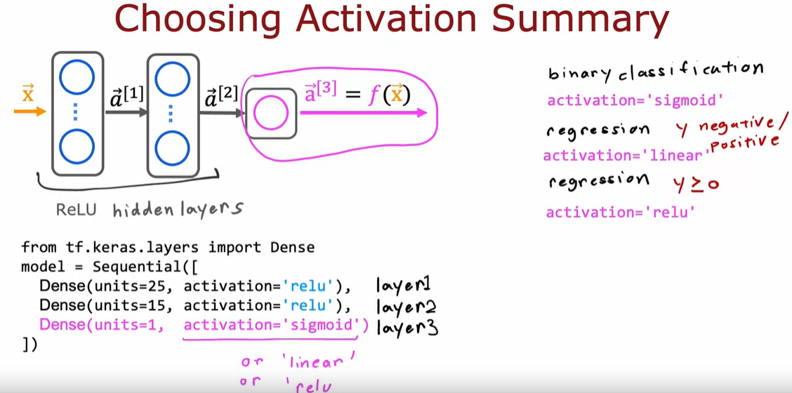
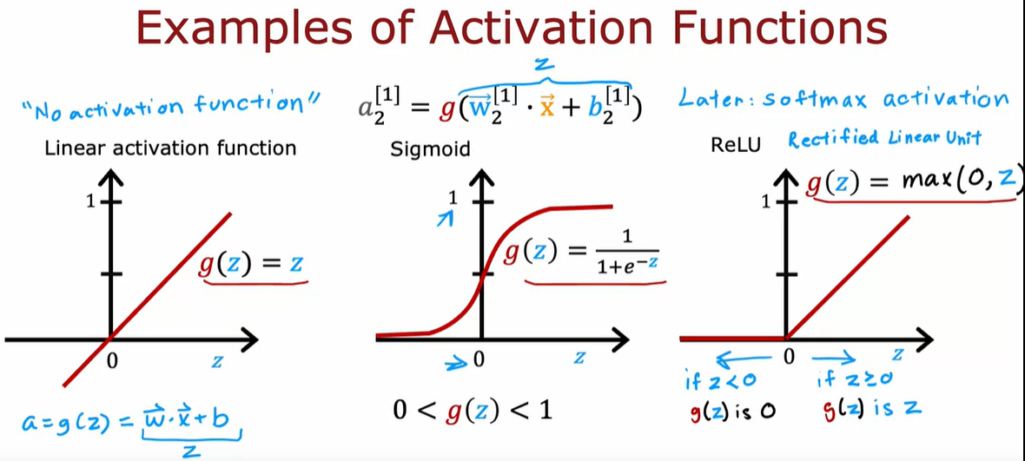
Why do we need activation functions? Why cant we use linear activation/no-activation all the time?
Using linear activation function for all neurons changes the NN to a linear model and thus the NN will not be able to fit anything more complex than a linear model. This is because the linear function of a linear function is itself a linear function. Furthermore, if we use linear activation for all hidden layers and use a logistic activation for the output layer, then the model is equivalent to a logistic regression model.
Another way to put this is that linear functions only represent linear transformations (scaling the number by a certain factor, rotating, etc.). Many real world problems have a non-linear relationship between inputs and outputs
Thus, to fit complex features and learn complex relationships between the hidden variables, we use a non-linear function such as the RELU.

Slide 18
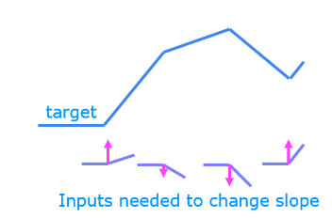
Notes on RELU activation
- The sigmoid function is best for on/off binary situations. The Relu provides a continuous linear relationship and has an “off” range when the value is zero. The “off” feature makes RELU a non-linear activation function.
The function shown is piecewise linear – the slope is consistent during the linear portion and then changes abruptly at the transition points.
At the transition points, a new linear function is added which produces a new slope. This new function, however, does not contribute to the slope prior to the transition point.
The non-linear activation function is responsible for disabling the input prior to and sometimes after the transition point
Relu’s non-linear behaviour provides the needed ability to turn on/off functions/units – Relu will cut-off a function/unit preventing it from interfering it with the next unit. The Relu zeros a unit till it reaches the right threshold to match the output. This “off” or disable feature of Relu enables models to stitch together linear segments and model complex-non-linear functions.
Note: Try out this lab during premium subscription

Slide 19
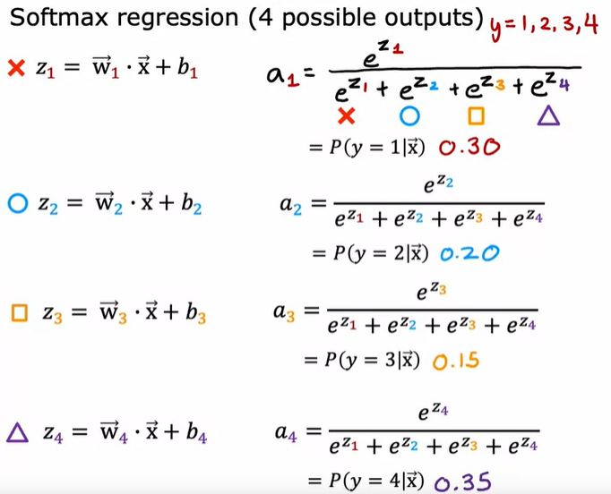
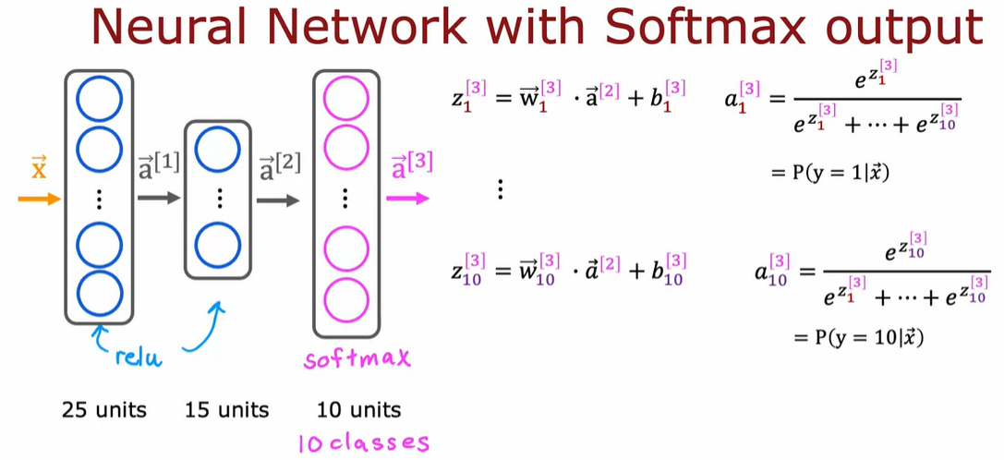
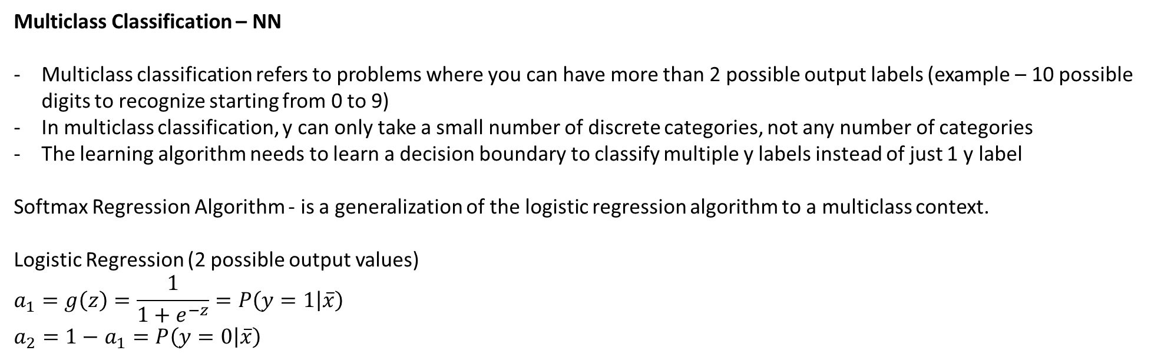
Multiclass Classification – NN
Multiclass classification refers to problems where you can have more than 2 possible output labels (example – 10 possible digits to recognize starting from 0 to 9)
In multiclass classification, y can only take a small number of discrete categories, not any number of categories
The learning algorithm needs to learn a decision boundary to classify multiple y labels instead of just 1 y label
Softmax Regression Algorithm - is a generalization of the logistic regression algorithm to a multiclass context.
Logistic Regression (2 possible output values)
$$a_{1}=g\left(z\right)=\frac{1}{1+e^{−z}}=P\left(y=1 | \overline{x}\right)$$
$a_{2}=1−$ $a_{1}=P\left(y=0 | \overline{x}\right)$
In order to carry out multiclass classification, the softmax layer is added only to the OUTPUT LAYER of the NN. In order to do so, the output layer needs to have the same number of units a the categories of label y.

Slide 20
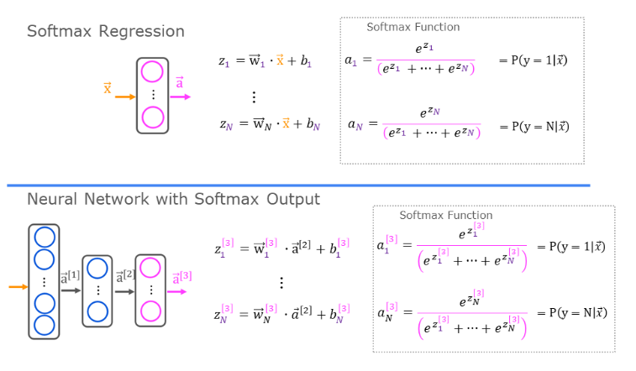
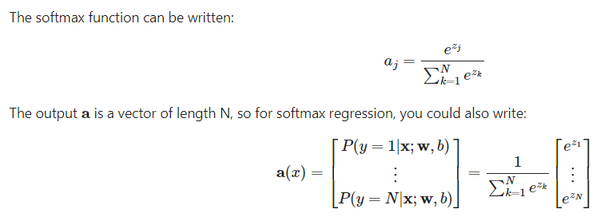
In both softmax regression and NN with softmax output, N outputs are generated and 1 output is selected as the predicted category.
In both cases, a vector z is generated by a Linear function, which is applied to the softmax function. The softmax function converts the z vector into a probability distribution.
After applying softmax, each output will be between 0 and 1, and the outputs will add to 1, so they can be interpreted as probabilities. The larger inputs will correspond to a larger output probability.
The exponential in the numerator of the softmax magnifies small difference in values
The output values sum to 1
The softmax spans all the outputs – a change in any of the z values will affect other z values.

Slide 21
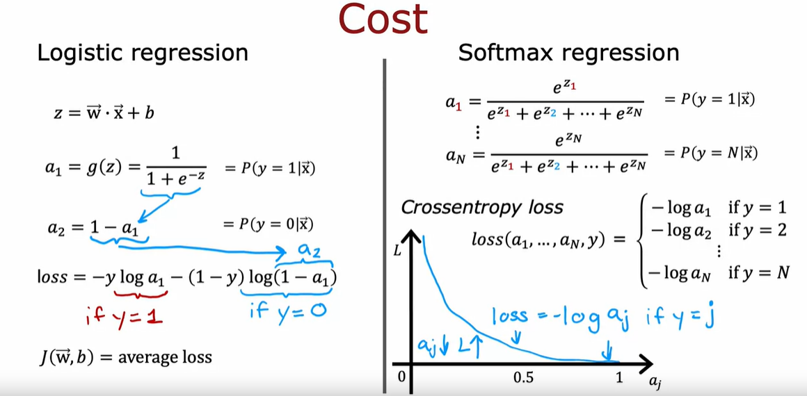
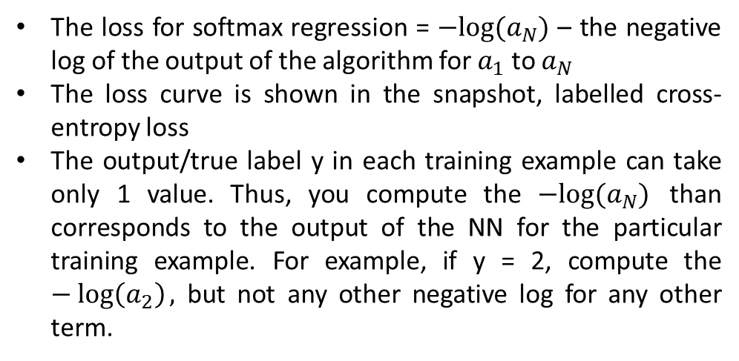
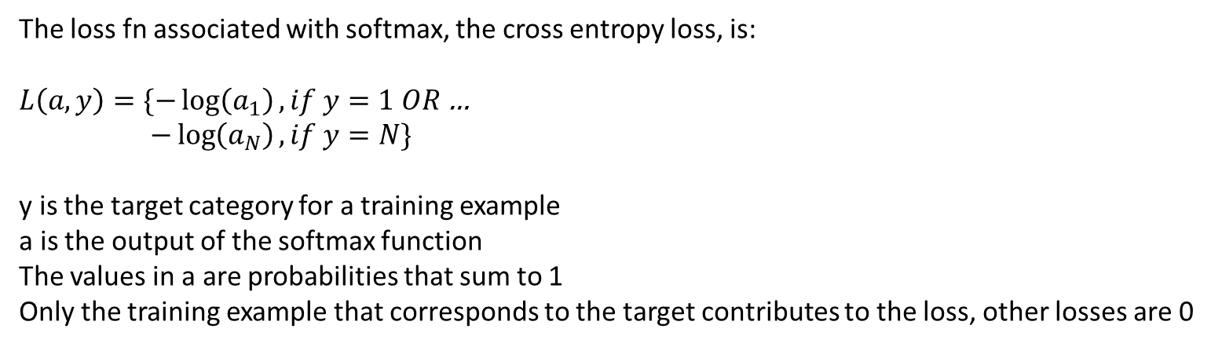
Cost Function for Softmax Regression
The loss for softmax regression = $−log⁡(a_{N})$ – the negative log of the output of the algorithm for $a_{1}$ to $a_{N}$
The loss curve is shown in the snapshot, labelled cross-entropy loss
The output/true label y in each training example can take only 1 value. Thus, you compute the $−log⁡(a_{N})$ than corresponds to the output of the NN for the particular training example. For example, if y = 2, compute the $−\log\left(a_{2}\right),$ but not any other negative log for any other term.
The loss fn associated with softmax, the cross entropy loss, is:
$L\left(a,y\right)=\{−\log\left(a_{1}\right), if y=1 OR$…
$−\log\left(a_{N}\right), if y=N\}$
y is the target category for a training example
a is the output of the softmax function
The values in a are probabilities that sum to 1
Only the training example that corresponds to the target contributes to the loss, other losses are 0

Slide 22
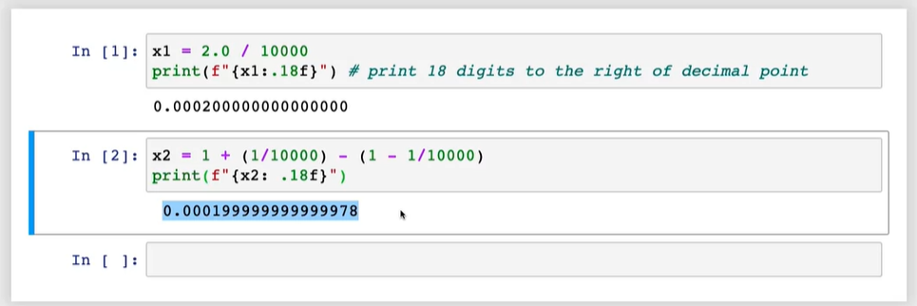

To write the cost function, we use an indicator function that will be 1 when the index matches the target and zero otherwise:
$$1\left\{y==n\right\}=\left\{1, if y=n, 0 otherwise\right\}$$
Thus, the cost, which the avg of all losses, is given by:
$$J\left(w,b\right)=−\frac{1}{m}[\sum_{i=1}^{m}{\sum_{j=1}^{n}{1\{y^{(i)}==n\}\frac{\log{e^{z_{j}^{(i)}}}}{\sum_{k=1}^{n}{k^{(i)}}}}}$$
M = number of examples
N = number of outputs
Tensorflow Implementation
This is because the computer only has a finite amount of memory to store the floating point number. Depending on how we decide the compute values, the result can have more or less numerical round off errors. To avoid this is Tensorflow, we use a different implementation of softmax.

Slide 23




The trick is to avoid saving an intermediate variable. Instead, specifying the expression directly as an activation function gives more flexibility in computation and reduces the round-off error.
*MNIST is the name of the dataset

Slide 24


Multilabel Classification
In multilabel classification, a single input X can be associated with multiple outputs y1, y2, etc. Thus, the target output y is a vector of N numbers
Multi-Class
Multi-Label
X | Y
.. | 1
.. | 2
.. | 1
.. | 2
X | Y1 | Y2 | … | Yn
… | 1 | 1 | … | 0
… | 1 | 0 | … | 1
… | 1 | 0 | … | 0
… | 1 | 1 | … | 1
How to build a multi-label NN?
Approach 1 – Build a separate NN for each label and train N neural networks.
Approach 2 – Train 1 NN with n outputs and output N activations in the final layer by changing the final layer to sigmoid. In this case, the sigmoid will not add up to 1. Also, use a threshold for each output neuron to classify the final output for that neuron (each neuron belongs to 1 possible label)
Car: Y/N
Output layer:
Person: Y/N
Bus: Y/N

Slide 25


Advanced Optimization - ADAM (Adaptive Momentum Estimation)
If the learning rate of Gradient Descent is too small, and we are taking tiny steps in the same direction over and over, the ADAM algorithm makes the learning rate bigger. Alternatively, if the gradient descent algorithm is osciallting back and forth, ADAM will adjust the learning rate to a smaller rate to take a more smooth path to find the minima. Thus, the ADAM algorithm can adjust the learning rate automatically. Furthermore, ADAM does not use 1 learning rate for all parameters, it uses a different learning rate for each parameter.
Overall, ADAM is more robust to the learning rate picked
$$w_{1}=w_{1}−∝_{1}\frac{∂}{∂w_{1}}J\left(\overline{w},b\right)$$
…
$$w_{n}=w_{n}−∝_{n}\frac{∂}{∂w_{n}}J(\overline{w},b)$$
$$b=b−∝_{n+1}\frac{∂}{∂w_{1}}J(\overline{w},b)$$
If a parameter (w or b) keeps moving in the same direction, the learning rate is increased for that parameter only to go faster in that direction and vice-versa

Slide 26


Additional Layer Types- CNN (Convolutional Neural Networks)
To recap, in the dense NN architecture, each neuron output is a function of all the activation outputs of the previous layers – for example, the 2nd layer is a function of every single activation value of the first layer.
For Convolutional layers, each neuron looks only at a part of the previous layer’s output. Why?
- faster compute
- need less training data
- Less prone to overfitting
With convolutional layers, you have many architectural choices such as choosing the window size of inputs a single neuron should look at and the number of neurons a layer should have. By choosing the architecture layers efficiently, you can build new versions of NNs that are more powerful than some dense layer applications.

Slide 27

Backpropagation
Backprop is used for computing derivatives of the cost function w.r.t. parameters for gradient descent/ADAM in order to train the NN.
Concept 1 - Derivative
Derivate is the rate of change of a function with respect to its input. In case of gradient descent, if the value of parameter w goes up by $∈,$ it is the change in J(w) as a consequence. Example
$$Let cost function:J\left(w\right)=w^{2}$$
$$Derivative:\frac{∂}{∂w}J\left(w\right)=2w$$
Formally, if w increases by $∈$, J(w) increases by K* $∈$, then $\frac{∂}{∂w}J\left(w\right)=k$, which in this case is 2w. The slope of a line corresponds to the derivative of a function.
If the derivative is small, the update step in gradient descent will make a small change to the parameter w, because changing w does not does not decrease the cost much. If the derivate term is large, the update step will drastically change the value of w because changing w is making a big difference in how much the cost can change!
Derivative examples – next slide

Slide 28


Concept2 - Computation Graphs
A computation graph is used for automatically computing derivatives of NNs. It’s an implementation technique in frameworks such as TF.
A forward prop computation graph is exactly the steps that have been followed in the excel sheets so far, in which each intermediary calculation is saved as a new variable.

Slide 29

Forward prop Example – Computation Graph
For backprop, a computation graph uses chain rule to calculate, store and apply the derivative at each step. Before programming frameworks like TF/PyTorch, researchers used Calculus to compute derivatives for NNs, however, in modern programming frameworks, you can specify the activation/cost function and the framework will use a computation graph to implement back prop. Since the derivatives are calculated automatically, computation graphs are also called automatic differentiators (auto diffs).

Slide 30






Backprop for Linear Regression:
1] Cost Function for Linear Regression → $J\left(w,b\right)= \frac{1}{2m}\sum_{i=1}^{m}{[\left({wx}^{(i)}+b\right)−{y^{(i)}]}^{2}}$
2] Derivative of Cost function → $\frac{1}{m}\sum_{i=1}^{m}{ [\left({wx}^{\left(i\right)}+b\right)−y^{\left(i\right)}]x^{\left(i\right)}}$
3] Loss for 1 Training example → $\frac{1}{2}[\left(wx+b\right)−{y]}^{2}$
3] Derivative of Loss → [$\left(wx+b\right)−y]x$
Lets apply the computation graph technique for calculating the derivative:
$$STEP1: \frac{∂J}{∂d}=\frac{∂}{∂d}[\frac{1}{2}d^{2}]=d$$
$$STEP2A: \frac{∂J}{∂a}=\frac{∂}{∂a}\left[a−y\right]=1$$
equivalent to [$\frac{∂J}{∂d}$ X $\frac{∂J}{∂a}$]
$$STEP2B: \frac{∂J}{∂y}=\frac{∂}{∂y}\left[a−y\right]=1$$
can ignore this as y is not a parameter!
$$STEP3A: \frac{∂J}{∂c}=\frac{∂}{∂c}\left[c+b−y\right]=1$$
equivalent to [$\frac{∂J}{∂a}$ X $\frac{∂a}{∂c}$ ]
$$LOSS=\frac{1}{2}[\left(wx+b\right)−{y]}^{2}$$
Calculate the derivative at each step and multiply to get the final value = d * 1 * 1 * 1 * 1 * x = dx
c
$$=\frac{1}{2}[\left(c+b\right)−{y]}^{2}$$
$$STEP3B: \frac{∂J}{∂b}=\frac{∂}{∂b}\left[c+b−y\right]=1$$
equivalent to [$\frac{∂J}{∂a}$ X $\frac{∂a}{∂b}$ ]
$$LOSS=\frac{1}{2}d^{2}$$
a
$$=\frac{1}{2}[a−{y]}^{2}$$
$$STEP4: \frac{∂J}{∂w}=\frac{∂}{∂d}[wx+b−y]=x$$
d

Slide 31


Summary:
The sigmoid is best for “on/off” or binary situations.
The RELU provides a continuous linear relationship. Additionally, the RELU has an “off” range when the output is zero and this feature makes RELU a non-linear activation function
A multi-class NN generates N outputs. One output is selected as the predicted answer using the softmax function. After applying softmax, each adding output will sum to 1. This can be interpreted as probabilities. The larger inputs for softmax will correspond to larger output probabilities.
For multi-label using the sigmoid unit in the output layer and decide to final threshold to classify each output label

Slide 32
Applying Machine Learning
If a ML system makes unacceptably large errors in prediction, it is possible to try the below next:
Get more training examples
Try smaller set of features
Try additional features
Try polynomial features
Try increasing regularization parameter
Try decreasing regularization parameter
ML Diagnostics: A test that you can run to gain insight into what is or is not working with a learning algorithm and to gain guidance into improving its performance. Diagnostics can help determine one or many of the above steps that need to be followed.
A step before diagnostics is to systematically evaluate the ML model performance. To do so,
Split data in 70/30 or 80/20 split. These are known as Train and Test sets. Consequently, fit the model on the training set.
After fitting the best model and minimizing the cost function (using regularization), it is often useful to compute two additional metrics:
Test Error – Average error on the test set
Training Error – Measure of how well the algorithm is doing on the training set
For regression and classification errors, these errors can be calculated as follows. The equations are for the test set but the same can be applied to the training set:

Slide 33



Regression: $J\left(w,b\right)= \frac{1}{2m}\sum_{i=1}^{m}{{({\hat{y}}^{i}−y^{i})}^{2}=}\frac{1}{2m}\sum_{i=1}^{m}{{[f}_{w,b}{(\overline{x})}^{(i)}−{y^{(i)}]}^{2}}$
Classification : $J\left(\overline{w},b\right)=\frac{1}{m}\sum_{i=1}^{m}{[L\left(f_{\overline{w},b}\left(x^{\left(i\right)},y^{\left(i\right)}\right)\right]=}\frac{−1}{m}\sum_{i=1}^{m}{[y^{\left(i\right)}\log\left(f_{\overline{w},b}\left(x^{\left(i\right)}\right)\right)+\left(1−y^{\left(i\right)}\right)log⁡(1−f_{\overline{w},b}\left(x^{\left(i\right)}\right)) }$
Alternatively, Classification: $ify^{\left(i\right)}=1 if{ f}_{w,b}{(\overline{x})}^{(i)}≥0.5 or 0 otherwise$ (count $\hat{y} ≠y$)
The training error is usually not a good indicator of how well the model will generalize to a dataset. Conversely, the test error is a better indicator of how well the model will generalize on new data.
Model Selection and Dev Set
On fitting multiple models to a dataset, the model having the lowest test error is usually the model that can be generalized. However, this is not the best approach! – Reason: The test error for the best model is an optimistic estimate of the generalized error because the extra parameter d was chosen using the test set, meaning that parameter depends on the test set. Thus, this error is likely to be lower than the actual generalization error.

Slide 34
We thus modify the procedure for model selection as follows: we split the data into 3 different subsets:
Train, Validation, Test following the split rule 60%, 20%, 20%
The validation set is also know as the cross validation set or the development set or the dev set. This is now used for checking the validity and accuracy of different models.
Thus, we also calculate 3 sets of error metrics to measure the model performance instead of two – training error, cv error and test error. Once we fit the model on the training set, we use the cv set to decide the model with the lowest cv error. Finally, we report the model accuracy on the test set. The test error is then a true generalization of the error.
The same approach is followed when choosing layers of NN architecture:
When fitting a model, we might consider different architectures (small to large)
To help decide the layers and the number of units per layer, you first train the model on the training set and then evaluate the model on the dev set.
After picking the model with the lowest cv error, you choose the test set to report how well the model will generalize
Thus, all decisions related to the model architecture are made using the training and the dev set alone. This ensure that the test set is a fair and not overly optimistic estimate of how well the model will generalize on new data.

Slide 35
Bias & Variance
A key step in building ML models is deciding what to do next after creating the first version of the model. Looking and the bias and variance gives good guidance on what to try next.
High Bias means we have underfit the dataset
High Variance means we have overfit the dataset
To check for high bias or variance, we check the performance of the model on training and dev set
J-Train | J-CV | Diagnostic
High | High | Underfit – High Bias & High Variance
High | Low | High Bias
Low | High | Overfit –High Variance
Low | Low | Good model
In general, fitting a higher and higher degree of polynomial on the training data will make the training error go down (assuming no regularization). However, based on the degree of polynomial, the cv cost would first come down and then go back up due to overfitting.
For high bias and high variance problems, we overfit a part of the trainset and underfit a part of the train set.

Slide 36

How regularization affects bias and variance?
The choice of regularization parameter lambda affects bias/variance of the model as follows:
- If lambda is very large, the algorithm is highly motivated to keep the weights very small and hence the weights will not have a great effect on the output.
If lambda = 0, there is no regularization applied and hence there are chances of overfitting
To choose an optimal value of lambda, we use the cross-validation set.

Slide 37


To choose lambda, we use the same method of choosing the degree of polynomial alpha – try a range of lambda values. After choosing the degree of polynomial that fits the data best, you can then tune over different values of lambda to find the best value

Slide 38

Choosing lambda=0 results in a high variance problem – Jtrain is small and Jcv is high.
Choosing a very high lambda will result in a high bias and high variance problem.
How to know if Jtrain/Jcv is high or low?
It is often useful to measure the baseline performance and check if the training error has a higher gap when compared to the baseline error. Baseline performance can be measure by the following:
Human level performance
Competing algo performance
Guess based experience/null model error
Once the baseline error performance is know, the 2 key quantities to measure are:
Difference between baseline performance and training error (if large – then high bias problem)
Difference between training error and test error (if large – high variance problem)

Slide 39

Learning Curves
Learning curves are a way to understand how learning algo is doing as a function of the amount of experience it has (the # of training examples it has seen).
When training set size increases, the training error will actually INCREASE. The cross validation error usually decreases. This is because it is harder to fit an exact model on all the examples more perfectly. Thus, with an even larger training set, it gets harder and harder to fit every training example perfectly.
In the next snapshot, note that the cv error is always higher than the training error.

Slide 40


High Bias vs the number of training examples:
- For high bias problems, the training error increases as the number of training examples increase but then flattens out – this means adding more training data does not help. Similarly, the cv error will come down and also flatten after a while. Lastly, human level performance will be better (much lower) than the training error indicating a high bias.

Slide 41

High Variance vs the number of training examples:
For this scenario, training error will increase as the training set size increases and dev error will be much higher than the training error. There will be a huge gap between both these errors. Also, training error will be much lower than the human level performance (indicating a high performing model that is overfitting). The main signal is that cross val error is much higher than the training error.
In this case, increasing the training set size can actually help – this will lower the cv error and bring it closer to the human error, also reducing the gap between the cv error and the training error.
How to plot learning curves?
If you have a model with 1000 training examples, you can plot the training error and dev error for different subsets of data – 100 examples, 200 examples, etc.
Downside – computationally expensive to train many different models

Slide 42
What to try next?
Fix High Variance problems:
Get more training examples – if the learning algo is overfitting on a small training set, getting more examples will improve the model performance
Increasing regularization parameter lambda – reduces overfitting and generalizes the model better by creating a more smoother fitting function
Try smaller set of features – if the algorithm has a lot of features that are not helpful or are redundant, eliminating features will help reduce model flexibility and thus reducing data overfitting
Fix High Bias problems:
Try getting additional features – instead of trying a smaller set of features, getting or creating more features will help create a more complex model
Add polynomial features – similar to adding more features, this will help fit the training data better
Decreasing regularization parameter lambda – more attention is paid to the original weights of a model, encouraging a better fit.
Bias/Variance – Neural Networks
One reason why NNs have been successful because NNs, together with the idea of big data, has given new ways to address both bias and variance.
Before NNs, ML engineers had to address the bias/variance trade off (trade off between having a too simple model, meaning high bias, or a too complex model, meaning high variance)
Large NNs, when trained on smaller datasets, are LOW BIAS machines. Using the below process, quite a few NNs address the bias/variance problem

Slide 43

Explanation:
1] Fit a model on the training set → check the training error → fit a bigger and bigger model on the training set till the training error is lower than the baseline error
2] Then start measuring the dev error → if the dev error is too high, get more training data
3] After getting more data → recheck the train and dev error
4] Use the high bias/variance diagnostics to address issues during re-training and re-fitting
Limitations:
Training a big NN is computationally expensive
More data may or may not be available
A large NN will usually do well or better than a small NN so long as regularization is chosen properly.

Slide 44


Slide 45

Iterative loop of ML development
Step1: Decide overall architecture of the ML system ( Choose the ML model, decide data, pick hyper parameters, etc.)
Step2: Train model
Step3: Implement diagnostics
Step4: Based on insights from diagnostics, make decisions
Error Analysis
The most important way to run diagnostics is bais/variance. The next important idea is error analysis.
Error analysis means manually looking at misclassified examples and trying to gain insights into where the algo is going wrong.
After identifying misclassified examples, we try to group them into common themes or properties or traits. Then prioritize which category to solve for
The categories do not necessarily need to be mutually exclusive but can be overlapping
If the number of misclassified examples is too large – sample
Limitation: it is much easier to do error analysis for problems that humans are good at
Summary: error analysis can be helpful for focusing attention on the more promising things to try

Slide 46

Adding more data in a ML development process
Trying to get data of all types can be slow and expensive
Adding more data of the type indicated by error analysis might help to have a more targeted effort. Sometimes, this could require labelling unlabelled data
Data Augmentation: taking existing training example to create new training example
Example: Image based problems – rotating, enlarging, shaking, contrasting or introducing distortions in the image can lead to new training examples
Example: Take an image, place a grid on top of it, introduce random warping around the grid
Example: For speech problems – augmenting original audio with a noisy background
Note: the changes or augmentation made to the data should be representative of the types of noise or distortion in the test set. In contrast, it is usally NOT helpful to add purely random meaningless noise to the data
Data Synthesis: using artificial data inputs (synthetic data) to create new training examples.

Slide 47

Transfer Learning
In this approach, first train a NN having a large number of target values (Y). Then take a copy of the NN and replace on the last layer (target/output layer) with a much smaller layer representative of the new target. This new layer will need to be trained again. Thus, use the existing trained parameters as a starting point to train the new output layer. There are 2 options to train:
Only train the output layer parameters – use if very small training set
Train all parameters of the network – use if large training set available
The idea of transfer learning is that NNs might have learned plausible set of parameters for processing inputs. Transferring these inputs to a new NN that starts off with these parameters is a much better place to start training on new outputs. Thus, with a little bit of further learning, the model can fit the new target.
Note:
The step of training a new NN from scratch on a large dataset (may not be related to the task at hand) is called SUPERVISED PRE-TRAINING
The 2nd step of taking the initially trained parameters from supervised pre-training and running gradient descent to further refine the weights to suite a specific application is called FINE TUNING

Slide 48

Why does transfer learning work?
The initial layers of NN usually learn low level features. As the number of layers increased or are progressed, the NN learns more complex features. Having been through a diverse dataset, NN learns generic features that are useful for solving many tasks. However, this only works for the same input type – a NN that is pre-trained on audio will not work too good for fine-tuning an image dataset.

Slide 49


Full Cycle of ML Development

Slide 50

Error Metrics for Skewed Datasets
If the ratio of the positive to negative examples is skewed, then usual error metrics such as accuracy do not work well. Also, since the data is skewed, incremental changes to the accuracy do not mean much and it is difficult to select the best algorithm
For skewed dataset, a common pair of error metrics to view is PRECISION/RECALL
Actual | Predicted | Metric
1 | 1 | True Positive
1 | 0 | False Negative
0 | 1 | False Positive
0 | 0 | True Negative
Predicted/Actual | 1 | 0
1 | True Positive | False Positive
0 | False Negative | True Negative
Precision means that for the predictions made by the model, it was right x% of the times. If the precision is high, the model is reasonably accurate as it takes into account the “accuracy” of the prediction.
Recall takes into account the “correctness” of the prediction. It measures if the actual positives were correctly captured or not and helps to check if the algorithm is predicting the same output all the time. More like coverage of positive values.
$$Precision=\frac{TP}{Predicted Positives}=\frac{TP}{TP+FP}$$
$$Recall=\frac{TP}{Actual Positives}=\frac{TP}{TP+FN}$$

Slide 51


In algorithms such as logistic regression, threshold are using for classifying the final labels –
RAISING the threshold will lead to higher precision but lower recall. This is because only if the model is very confident, it will predict the positive class. However, it will then miss out on the actual positives.
Example: Out of 10 patients having a disease, it will predict only 2 patients and both will be correct (high precision) but it will fail to predict the other 8 (low recall)
LOWERING the threshold will lead to higher recall but lower precision. This is because, when in doubt, the model will predict 1 (positive class)
Thus, choosing the threshold helps make a trade-off between precision and recall.
The f-1 score combines precision and recall. The final score gives emphasis to value which is lower. The f-1 score is the harmonic mean of the precision and recall
$$F1=\frac{1}{1/2(\frac{1}{P}+\frac{1}{R})}=2\frac{ PR}{P+R}$$

